Slide 1
Are You an Accident of Nature?
Part 10
Fossils

Slide 2
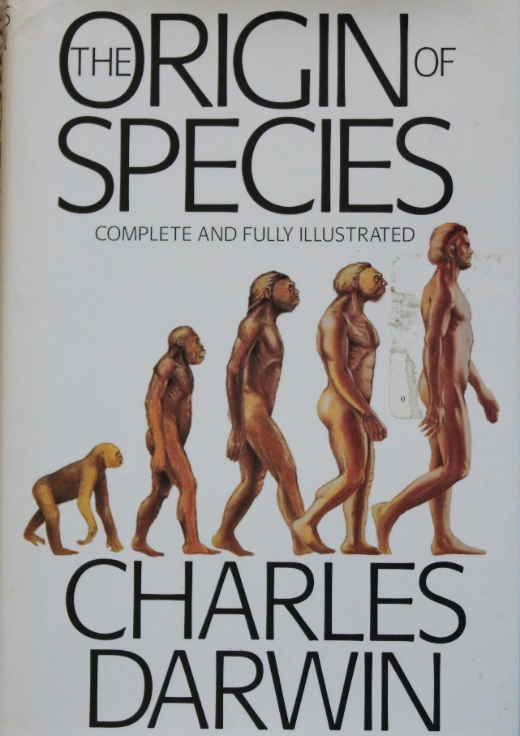
Fossil record does not support evolution.
  Darwin wrote fossils did not support his theory
Notes:
From http://creation.com/fossils-out-of-order
1) Perhaps most astonishingly, pollen fossils—evidence of flowering plants—were found in the Precambrian strata. According to evolutionists, flowering plants first evolved 160 mya, but the Precambrian strata is older than 550 mya.
2) Dinosaurs are supposed to have evolved into birds. But Confuciusorniswas a true beaked bird that pre-dates the ‘feathered’ dinosaurs that it allegedly came from. It also has been found in the stomach of a dinosaur.
3) Grass which has been found in fossilized dinosaur coprolites (fossilized dung). But grass is not supposed to have evolved until at least 10 million years after the dinosaurs went extinct.
4) A dog-like mammal fossil was found with remains of dinosaurs in its stomach—but no mammals large enough to prey on dinosaurs were supposed to exist alongside them.
5) A mammal hair was found in amber supposed 100 million years old. Once again, this is smack in the middle of the alleged ‘age of dinosaurs’ when no such mammals existed.
.
http://creation.com/dino-dinner-hard-to-swallow January 21, 2005
A recent fossil discovery in China has evolutionists scratching their heads over a mammal’s last meal.
The fossilized remains of a small dinosaur (psittacosaur) have been found in the belly of a dog-like mammal named Repenomamus robustus. Researchers have also found a second fossil that they have named Repenomamus giganticus. This second fossil has been described as “breathtaking” and “about the size of a modern dog.”¹ This is a real surprise for evolutionists because evolutionary assumptions say that mammals living during the so-called “age of the dinosaurs” couldn’t possibly have been that big; rather, they had to be small to better avoid the huge reptiles. It has some evolutionary scientists quite concerned, for it challenges what they have believed for years.
References
Verrengia, J., “Mammal ate dinosaur, to scientists’ surprise,” Cincinnati Enquirer, A5, January 13, 2005.
Hu, Y., Meng, J., Wang, Y. & Li, C. “Large Mesozoic mammals fed on young dinosaurs,” Nature 433:149–152, January 13, 2005.
Weil, A. “Living large in the Cretaceous,” Nature 433:116–117, January 13, 2005.

Slide 3
Fossil record does not support evolution.
  Transition fossils missing
  Interpretation is subjective
  Out of sequence fossils
  (wrong order)
Notes:
From http://creation.com/fossils-out-of-order
1) Perhaps most astonishingly, pollen fossils—evidence of flowering plants—were found in the Precambrian strata. According to evolutionists, flowering plants first evolved 160 mya, but the Precambrian strata is older than 550 mya.
2) Dinosaurs are supposed to have evolved into birds. But Confuciusorniswas a true beaked bird that pre-dates the ‘feathered’ dinosaurs that it allegedly came from. It also has been found in the stomach of a dinosaur.
3) Grass which has been found in fossilized dinosaur coprolites (fossilized dung). But grass is not supposed to have evolved until at least 10 million years after the dinosaurs went extinct.
4) A dog-like mammal fossil was found with remains of dinosaurs in its stomach—but no mammals large enough to prey on dinosaurs were supposed to exist alongside them.
5) A mammal hair was found in amber supposed 100 million years old. Once again, this is smack in the middle of the alleged ‘age of dinosaurs’ when no such mammals existed.
.
http://creation.com/dino-dinner-hard-to-swallow January 21, 2005
A recent fossil discovery in China has evolutionists scratching their heads over a mammal’s last meal.
The fossilized remains of a small dinosaur (psittacosaur) have been found in the belly of a dog-like mammal named Repenomamus robustus. Researchers have also found a second fossil that they have named Repenomamus giganticus. This second fossil has been described as “breathtaking” and “about the size of a modern dog.”¹ This is a real surprise for evolutionists because evolutionary assumptions say that mammals living during the so-called “age of the dinosaurs” couldn’t possibly have been that big; rather, they had to be small to better avoid the huge reptiles. It has some evolutionary scientists quite concerned, for it challenges what they have believed for years.
References
Verrengia, J., “Mammal ate dinosaur, to scientists’ surprise,” Cincinnati Enquirer, A5, January 13, 2005.
Hu, Y., Meng, J., Wang, Y. & Li, C. “Large Mesozoic mammals fed on young dinosaurs,” Nature 433:149–152, January 13, 2005.
Weil, A. “Living large in the Cretaceous,” Nature 433:116–117, January 13, 2005.

Slide 4
No transition fossils
From mice to bats
From invertebrates (no backbone)
to vertebrates (with backbone)
In general, transitions missing

Slide 5
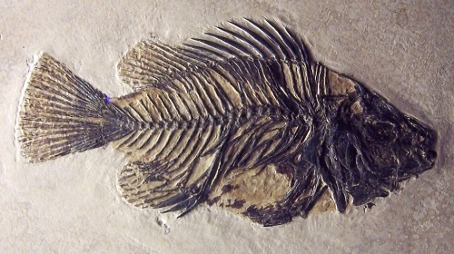

Transitions Missing
Notes:
Lower fossils from Good_Free_Photos public_domain
Upper fish fossil from Wiki public domain

Slide 6
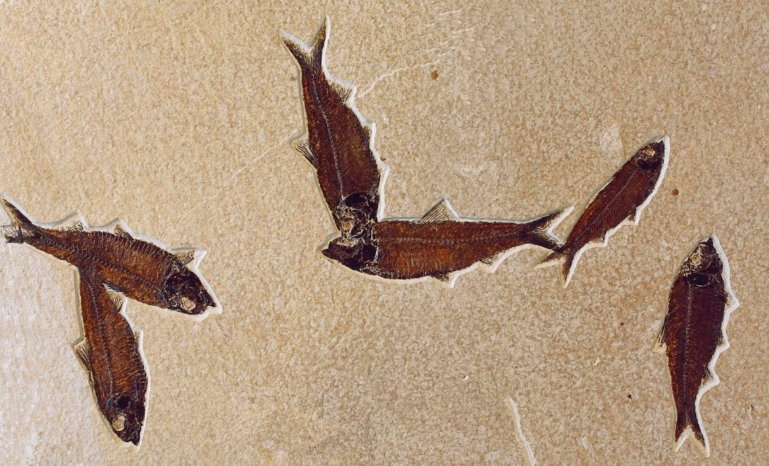
Billions of Fossil Fish
National Park Service photo

Slide 7
No scientifically rigorous proof of
evolution producing an increase in complexity.
Only subjective interpretations
Wishful thinking
Notes:
From http://creation.com/fossils-out-of-order
1) Perhaps most astonishingly, pollen fossils—evidence of flowering plants—were found in the Precambrian strata. According to evolutionists, flowering plants first evolved 160 mya, but the Precambrian strata is older than 550 mya.
2) Dinosaurs are supposed to have evolved into birds. But Confuciusorniswas a true beaked bird that pre-dates the ‘feathered’ dinosaurs that it allegedly came from. It also has been found in the stomach of a dinosaur.
3) Grass which has been found in fossilized dinosaur coprolites (fossilized dung). But grass is not supposed to have evolved until at least 10 million years after the dinosaurs went extinct.
4) A dog-like mammal fossil was found with remains of dinosaurs in its stomach—but no mammals large enough to prey on dinosaurs were supposed to exist alongside them.
5) A mammal hair was found in amber supposed 100 million years old. Once again, this is smack in the middle of the alleged ‘age of dinosaurs’ when no such mammals existed.
.
http://creation.com/dino-dinner-hard-to-swallow January 21, 2005
A recent fossil discovery in China has evolutionists scratching their heads over a mammal’s last meal.
The fossilized remains of a small dinosaur (psittacosaur) have been found in the belly of a dog-like mammal named Repenomamus robustus. Researchers have also found a second fossil that they have named Repenomamus giganticus. This second fossil has been described as “breathtaking” and “about the size of a modern dog.”¹ This is a real surprise for evolutionists because evolutionary assumptions say that mammals living during the so-called “age of the dinosaurs” couldn’t possibly have been that big; rather, they had to be small to better avoid the huge reptiles. It has some evolutionary scientists quite concerned, for it challenges what they have believed for years.
References
Verrengia, J., “Mammal ate dinosaur, to scientists’ surprise,” Cincinnati Enquirer, A5, January 13, 2005.
Hu, Y., Meng, J., Wang, Y. & Li, C. “Large Mesozoic mammals fed on young dinosaurs,” Nature 433:149–152, January 13, 2005.
Weil, A. “Living large in the Cretaceous,” Nature 433:116–117, January 13, 2005.

Slide 8

Notes:
All these types of dogs were created from a single common wolf like ancestor.

Slide 9

Notes:
The information for all them was contained in the wolf gene population.

Slide 10
Notes:
By careful breeding, humans selected genes for small dogs to get small dogs.
Breeding selected genes for big dogs to get big dogs.
But what really happened is that information was being removed.
The small dogs have lost the information to be a really big dog.
If you breed tiny dogs, you probably will never be able to get a really large dog again, because that information has been lost.
But if a million years from now an evolutionist were to dig up fossils of dogs like these, the evolutionist might interpret the bones as representing evolution – new information being created, when really we know that this did not happen. In fact, we now know from information science and DNA that new information cannot be created by mutations plus natural selection.
WE DO SEE NATURAL SELECTION
WE DO SEE ADAPTATION – OUTWARD CHANGES
WE DO NOT SEE NEW INFORMATION

Slide 11
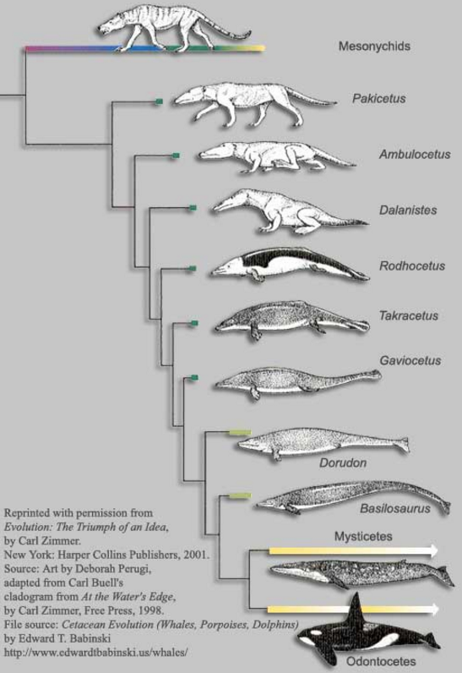
From coyote-like animal to a whale?
Notes:
Many evolutionists believe that a dog like animal changed into a whale over time. This diagram is featured in such books by prominent evolutionists such as Richard Dawkins and Carl Zimmer.
Used in the book “Evolution The Triumph of an Idea” by Carl Zimmer.
Source of this image, which can be found in the book, is
Source: PBS - WGBH Boston "Evolution" Project
http://etb-whales.blogspot.com/2012/03/whale-evolution-introduction-to.html
Image may be re-distributed on the condition that all credits stay intact:
Reprinted with permission from Evolution: The Triumph of an Idea, by Carl Zimmer. New York: HarperCollins Publishers, 2001. Source: Art by Deborah Perugi, adapted from Carl Buell's cladogram from At the Water's Edge, by Carl Zimmer, Free Press, 1998.
See the documentary video: Evolution: The Grand Experiment, Part 1
For an interview with Philip Gingerich, Univ of Michigan, who admits there are no bones found to support the idea the animal had a tail, and that he just guessed that the animal had a fluked tail, but no longer believes this.

Slide 12
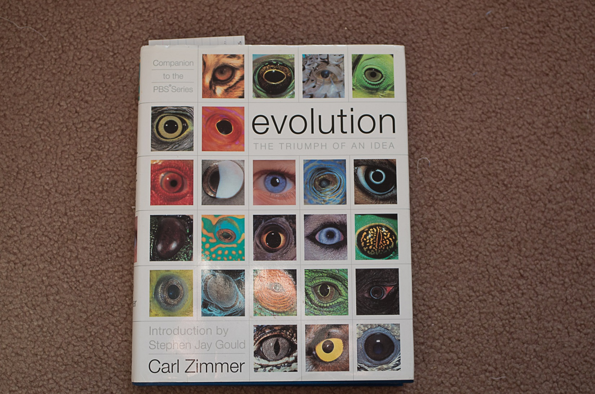
Carl Zimmer’s book
Notes:
Used in the book “Evolution The Triumph of an Idea” by Carl Zimmer,
Who is an evolutionist who writes science articles regularly published in the NY Times.

Slide 13

Richard Dawkin’s book
Notes:
This book, by Richard Dawkins, used the same artwork.
Dawkins is perhaps the most famous atheist/evolutionist.

Slide 14
It’s speculative artwork, not science.
Source:
Art by Deborah Perugi
Notes:
Philip Gingerich, Univ of Michigan admitted there were no fluke bones and he no longer believes Rodhocetus had a fluked tail.

Slide 15
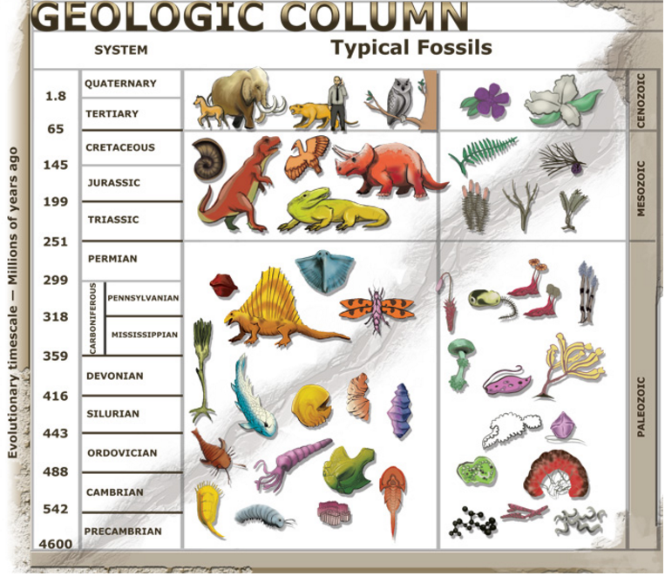
Flowering
Plants
Pollen
Notes:
Below is from: http://www.nature.com/nature/journal/v210/n5033/abs/210292a0.html
Nature 210, 292 - 294 (16 April 1966); doi:10.1038/210292a0
Occurrence of Pollen and Spores in the Roraima Formation of Venezuela and British Guiana
R. M. STAINFORTH
Asociación Venezolana de Geología, Minería y Petróleo, Apartado 4400, Chacao, Estado Miranda, Venezuela.
THE discovery of pollen and spores in beds considered Precambrian (Proterozoic) has received brief notice in geological journals and the press^{1–3}. Individual authors will doubtless publish detailed stratigraphic and palynologic accounts of the occurrence in due course. Meanwhile it is considered desirable to give an outline of the facts of the case before distorted interpretations develop from inadequate data. The following summary statement has been prepared jointly by several members of the Asociación Venezolana de Geología, Minería y Petróleo. A single author is nominated to simplify bibliographic references.

Slide 16
Out of Sequence Fossils
Pollen in Precambrian Rocks
Precambrian rocks are among the oldest.
According to evolution, plants that produce pollen did not come until much later.
J. R. M. Stainforth, “Occurrence of Pollen and Spores in the Roraima Formation of Venezuela and British Guiana,” Nature, Vol. 210, 16 April 1966, pp. 292–294.
Notes:
Below is from: http://www.nature.com/nature/journal/v210/n5033/abs/210292a0.html
Nature 210, 292 - 294 (16 April 1966); doi:10.1038/210292a0
Occurrence of Pollen and Spores in the Roraima Formation of Venezuela and British Guiana
R. M. STAINFORTH
Asociación Venezolana de Geología, Minería y Petróleo, Apartado 4400, Chacao, Estado Miranda, Venezuela.
THE discovery of pollen and spores in beds considered Precambrian (Proterozoic) has received brief notice in geological journals and the press^{1–3}. Individual authors will doubtless publish detailed stratigraphic and palynologic accounts of the occurrence in due course. Meanwhile it is considered desirable to give an outline of the facts of the case before distorted interpretations develop from inadequate data. The following summary statement has been prepared jointly by several members of the Asociación Venezolana de Geología, Minería y Petróleo. A single author is nominated to simplify bibliographic references.

Slide 17
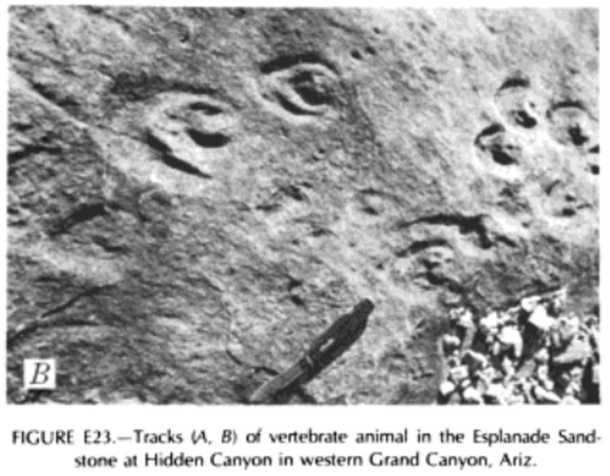
Horselike hoofprints in Grand Canyon
FIGURE E23.- Tracks (A, B) of vertebrate animal in the Esplanade Sand-
stone at Hidden Canyon in western Grand Canyon, Ariz.
Notes:
Horselike hoofprints in Grand Canyon in Esplanade Sandstone (early Permian)
A leading authority on the Grand Canyon published photographs of horselike hoofprints visible in rocks that, according to the theory of evolution, predate hoofed animals by more than 100 million years.^{c}
c . Edwin D. McKee, The Supai Group of Grand Canyon, Geological Survey Professional Paper 1173 (Washington, D.C.: U.S. Government Printing Office, 1982), pp. 93–96, 100

Slide 18
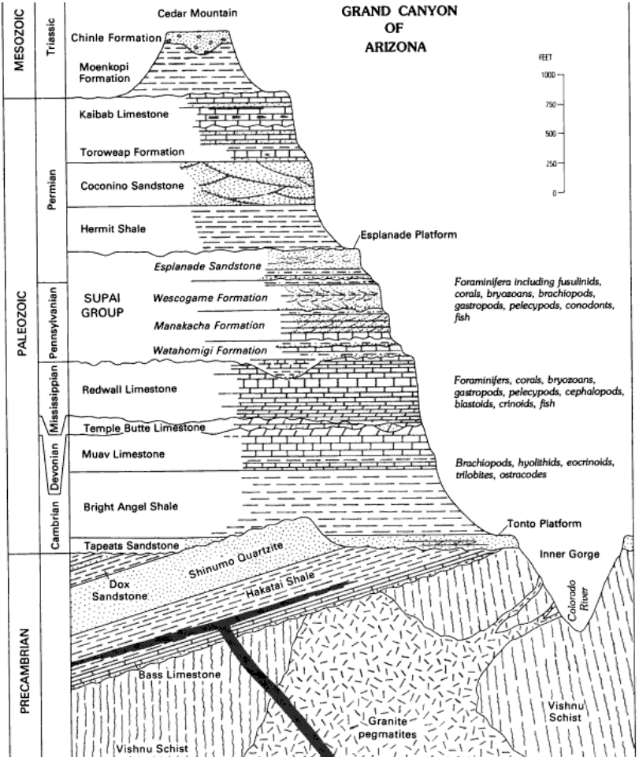
Horses supposedly evolved 55 mya
Horselike
footprints
visible 315 mya
Notes:
“The earliest known horses evolved 55 million years ago and for much of this time, multiple horse species lived at the same time, often side by side, as seen in this diorama.”
The Evolution of Horses - American Museum of Natural History
www.amnh.org/.../horse/the-evolutio...American Museum of Natural History
Esplanade Sandstone
Early Permian - 315 million years
(age used by National Park Service;
Mathis and Bowman, 2005)

Slide 19
Over 1,000 feet
Horselike
footprints
visible 315 mya
Notes:
Evolutionists like to try to explain away these types of fossils by guessing that a recent layer of rock was laid down and the more recent creatures created the footprints. But that cannot explain what we see here, because the rock layers are well defined and there is over 1,000 feet of highly studied old rock layers on top of the layer the footprints were photographed in. The photos appeared in a professional paper of the U.S. Geological Survey.
c . Edwin D. McKee, The Supai Group of Grand Canyon, Geological Survey Professional Paper 1173 (Washington, D.C.: U.S. Government Printing Office, 1982), pp. 93–96, 100

Slide 20
First
Dinosaurs
Triassic
Horselike
before dinosaurs!!
Notes:
Evolutionists like to try to explain away these types of fossils by guessing that a recent layer of rock was laid down and the more recent creatures created the footprints. But that does not work here, because there is over 1,000 feet of old rock layers on top of the layer the footprints were photographed in. The photos appeared in a professional report of the U.S. Geological Survey.
According to evolution, large mammals, like horses, did not come until after the age of dinosaurs. But according to actual fossil hoofprints, large horselike animals existed a long time before dinosaurs existed. So could not have been dinos with hoofs.

Slide 21
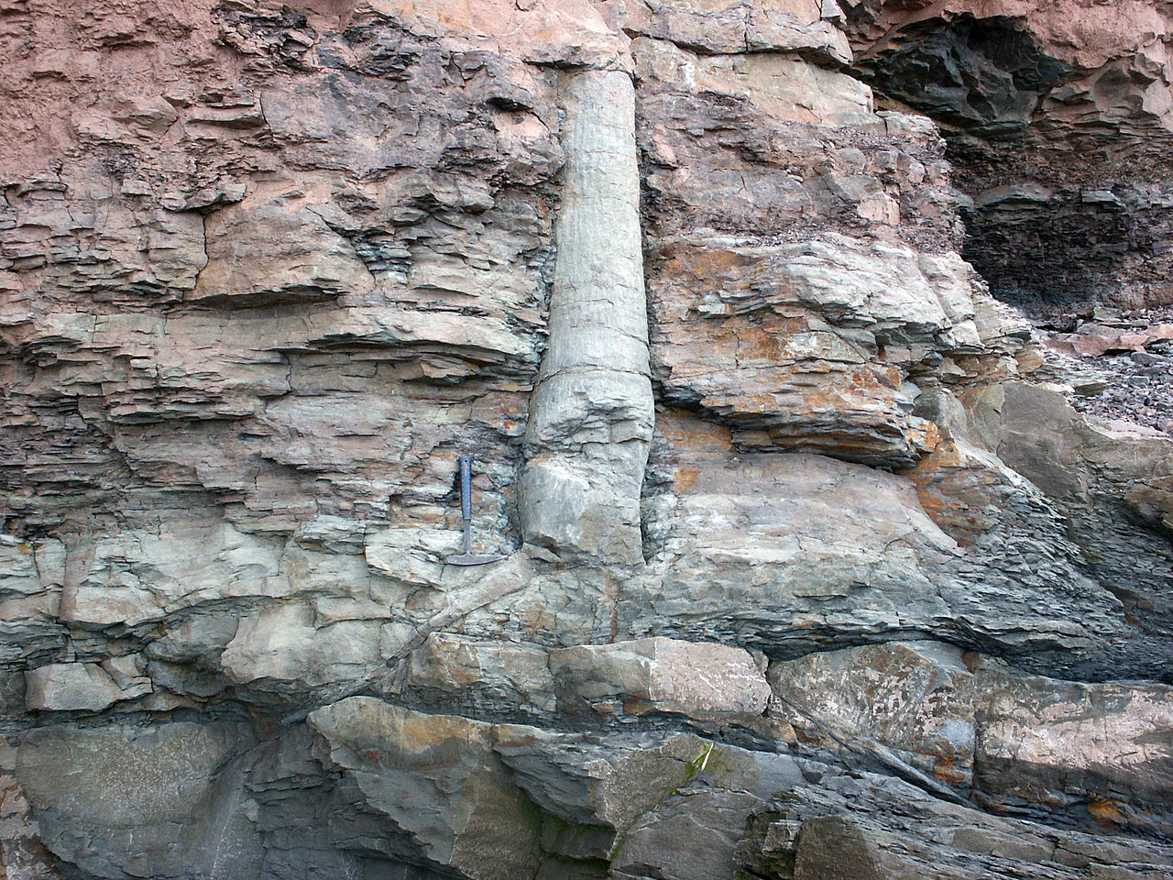
Polystrate Tree Fossil
Michael C. Rygel via Wikimedia Commons
Notes:
Here is a fossil tree that extends through many layers of rock. Obviously the tree did not grow up through the rock layers. The rocks layers were laid down very quickly by a flood. Trees that go through rock layers are common in coal mines. They often extend up through the layer of coal and are a danger to the miners. When the lower part of the tree is cut off, sometimes the upper part of the tree falls down into the mine and can kill a miner. A friend of Mike Derewianka in a geology class went to a coal mine (in Tennessee or Kentucky) and saw such a tree.

Slide 22
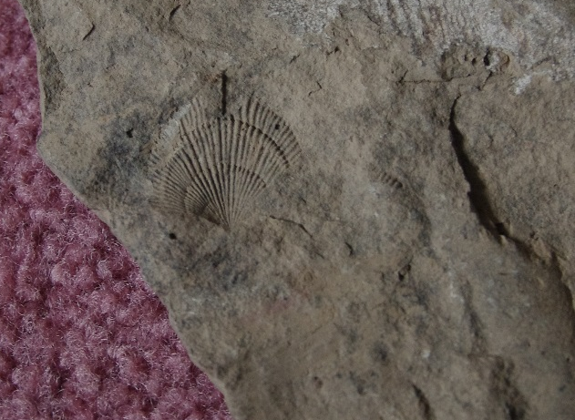
Sea Fossils on Mountains
Notes:
Marine fossils are found on the highest mountains all over the earth, including the Himalayas where Mount Everest is and Pike’s Peak in the American Rocky Mountains. This photo is of a fossil clam in shale taken at an elevation of 1700 feet above sea level in the state of New York. (photo by Michael Derewianka – public domain.)

Slide 23
Rock Layers – Wide Areas
Worldwide Flood
Tapeats Sandstone
Extends through much of North America
1,000s of miles
Notes:
The Tapeats Sandstone extends through much of North America, from Maine to Nevada and from Texas to the northern Canadian artic. Sandstones are formed by water deposits. Only a global flood like Noah’s Flood in the Bible could have carried the sediments needed to form it and other similar rock layers.

Slide 24
T-rex blood cells
“It as exactly like looking at a slice of modern bone. But, of course, I couldn’t believe it. I said to the lab technician: ‘The bones, after all, are 65 million years old. How could blood cells survive that long?”
Mary Schweitzer
Montana State Univ.
Museum of the Rockies, Science 261:260, July 9, 1994
Credit: Creation Ministries International

Slide 25
Fossils do not support evolution.

Slide 26
Great info on creation science
icr.org
Creation.com
AnswersInGenesis.org

Slide 27
Give your own presentations.
Free downloads of PowerPoints used in these videos at:
Educate7.com

